Slide 1

IMPLEMENTATION OF DOMAIN-KNOWLEDGE INTO THE MODELLING OF DYNAMIC SYSTEMS
MASTER’S THESIS (SS 2022)

Slide 2
Agenda
Introduction
Case Study
Continuous Stirred Tank Reactor (CSTR)
Neural Network
Hyperparameter Tuning
Physics Guided Neural Network

Slide 3




Goals of the Master Thesis
CSTR Implementation
Vanilla Neural Network
Hyperparameter Tuning with Keras Tuner
Physics Guided Neural Network
Model Predictive Controller (MPC) simulation
do-mpc toolbox
CasADi optimization
AMPR signal
NARX Neural Network
Python
Keras API fur tuning Hyperparameters
Open and Closed Loop Simulations
Writing custom physics constraints.
Influencing training of the neural network
Closed Loop Simulation

Slide 4
CSTR Implementation
Vanilla Neural Network
Hyperparameter Tuning with Keras Tuner
Physics Guided Neural Network

Slide 5
Case Study
Continuous Stirred Tank Reactor (CSTR)

Slide 6
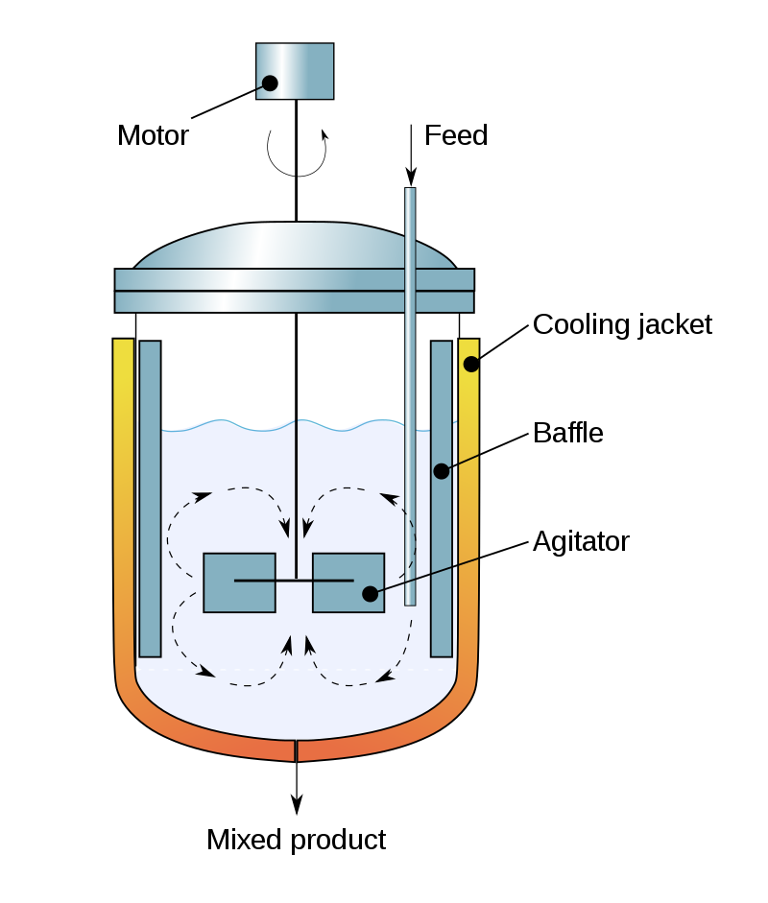
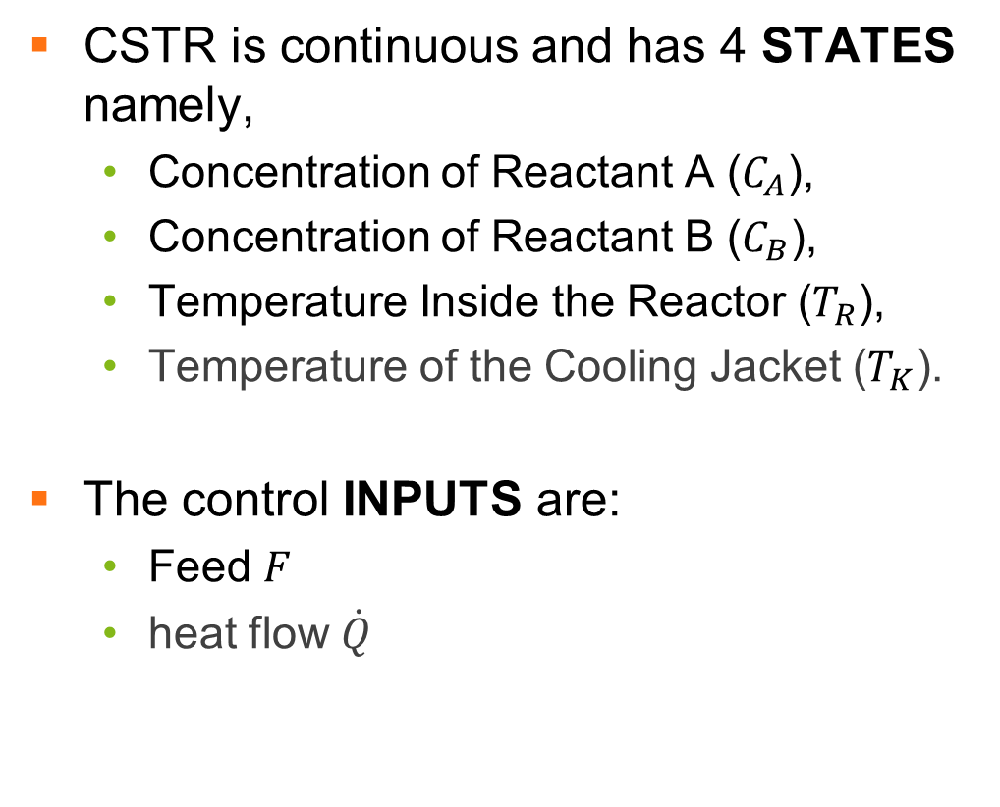
Continuous Stirred Tank Reactor (CSTR)
CSTR is continuous and has 4 STATES namely,
Concentration of Reactant A ($C_{A}$),
Concentration of Reactant B ($C_{B}$),
Temperature Inside the Reactor ($T_{R}$),
Temperature of the Cooling Jacket ($T_{K}$).
The control INPUTS are:
Feed $F_{ }$
heat flow $\dot{Q}$
Figure 1: The setup of a common Continuous Stirred-Tank Reactor (CSTR)
Notes:
Meet the plant, it consists of a coupled two-tanks system, where we have a constant inflow into tank 1, and the inflow into tank 2 is zero. Our states are the liquid heights. These states are controlled by the valves shown here, which are the manipulated variables. This leads to our system being a multiple input, multiple output system.

Slide 7

Continuous Stirred Tank Reactor (CSTR)
${\dot{C}}_{A}= F ∙\left(C_{A,0} −C_{A}\right)− k_{1}∙C_{A} −k_{3}∙{C_{A}^{2},}_{ }$
(1)
${\dot{C}}_{B}= F ∙C_{B}+{k_{1} ∙ C}_{A}− k_{2}∙C_{B},$
(2)
${\dot{T}}_{R}= \frac{{k_{1} ∙ C}_{A }∙ H_{R,ab} + k_{2 }∙ C_{B} ∙ H_{R,bc}+ k_{3 }∙ C_{A}^{2} ∙ H_{R,ad} + F ∙ \left(T_{in}− T_{R}\right) + \frac{K_{W} ∙ A_{R} ∙\left( T_{K}− T_{R}\right)}{ρ ∙ c_{p}∙ V_{R}} }{−ρ ∙ c_{p}}$
(3)
${\dot{T}}_{K}= \frac{ \dot{Q}+ k_{w} ∙A_{R}∙T_{dif}}{m_{k}∙ C_{p,k}}$
(4)

Slide 8

$k_{1}= β ∙k_{0,ab} ∙e^{\frac{{−E}_{A,ab}}{T_{R}+273.15}}$
(5)
$k_{2}= k_{0,bc} ∙e^{\frac{{−E}_{A,bc}}{T_{R} + 273.15}}$
(6)
$k_{3}= k_{0,ad} ∙e^{\frac{{−α ∙ E}_{A,ad}}{T_{R} + 273.15}}$
(7)

Slide 9
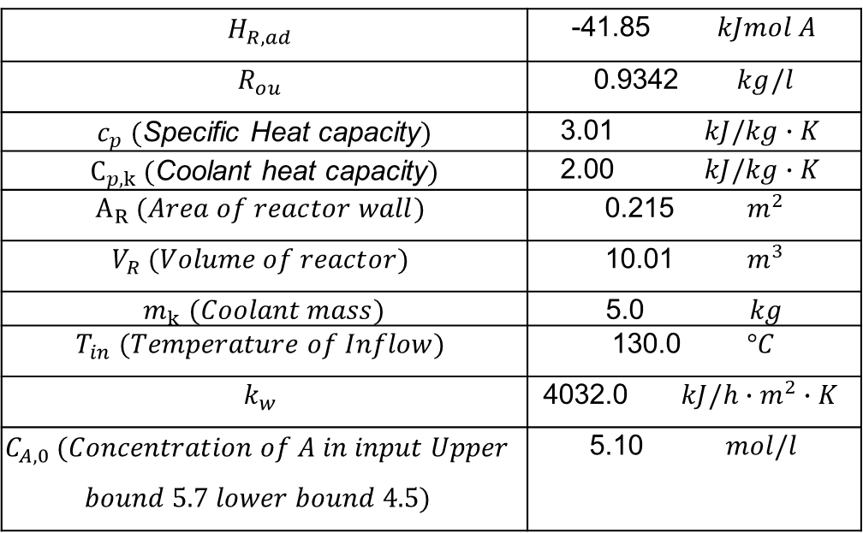
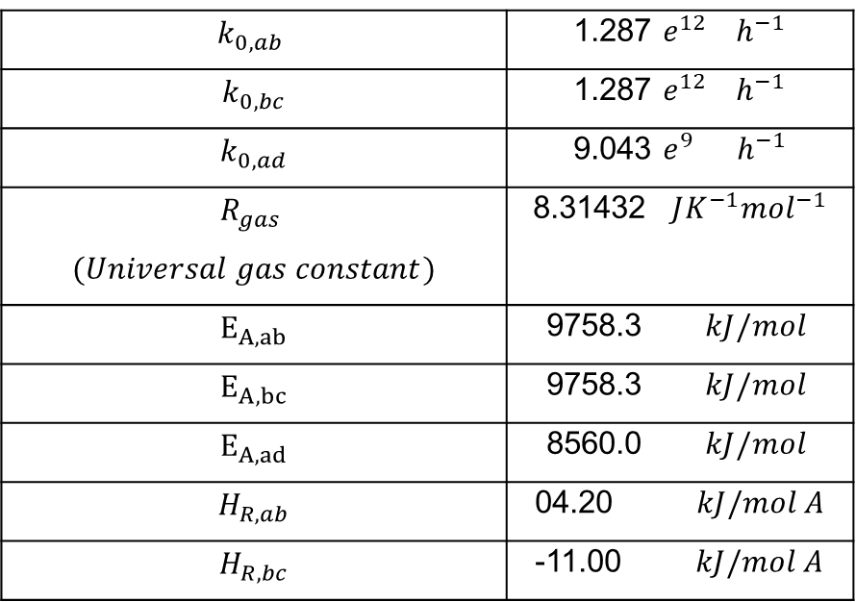
$$k_{0,ab}$$ | 1.287 $e^{12}{ h}^{−1}$
$$k_{0,bc}$$ | 1.287 $e^{12} { h}^{−1}$
$$k_{0,ad}$$ | 9.043 $e^{9}{ h}^{−1}$
$$R_{gas}$$ $$(Universal gas constant)$$ | 8.31432 $JK^{−1}{mol}^{−1}$
$$E_{A,ab}$$ | 9758.3 $kJ/{mol}^{ }$
$$E_{A,bc}$$ | 9758.3 $kJ/{mol}^{ }$
$$E_{A,ad}$$ | 8560.0 $kJ/{mol}^{ }$
$$H_{R,ab}$$ | 04.20 $kJ/{mol}^{ }A$
$$H_{R,bc}$$ | -11.00 $kJ/{mol}^{ }A$
$$H_{R,ad}$$ | -41.85 $kJ{mol}^{ }A$
$$R_{ou}$$ | 0.9342 $kg/l$
$c_{p} ($Specific Heat capacity$)$ | 3.01 $kJ/{kg∙K}^{ }$
$C_{p,k} ($Coolant heat capacity$)$ | 2.00 $kJ/{kg∙K}^{ }$
$$A_{R} (Area of reactor wall)$$ | 0.215 ${ m}^{2}$
$$V_{R} (Volume of reactor)$$ | 10.01 ${ m}^{3}$
$m_{k}$ $(Coolant mass)$ | 5.0 $kg$
$$T_{in} (Temperature of Inflow)$$ | 130.0 $°C$
$$k_{w}$$ | 4032.0 $kJ/{h{ ∙m}^{2}∙K}^{ }$
$$C_{A,0} (Concentration of A in input Upper$$ $$bound 5.7 lower bound 4.5)$$ | 5.10 $mol/l$
Table1: Certain parameters of the CSTR model
Table1: …continues

Slide 10
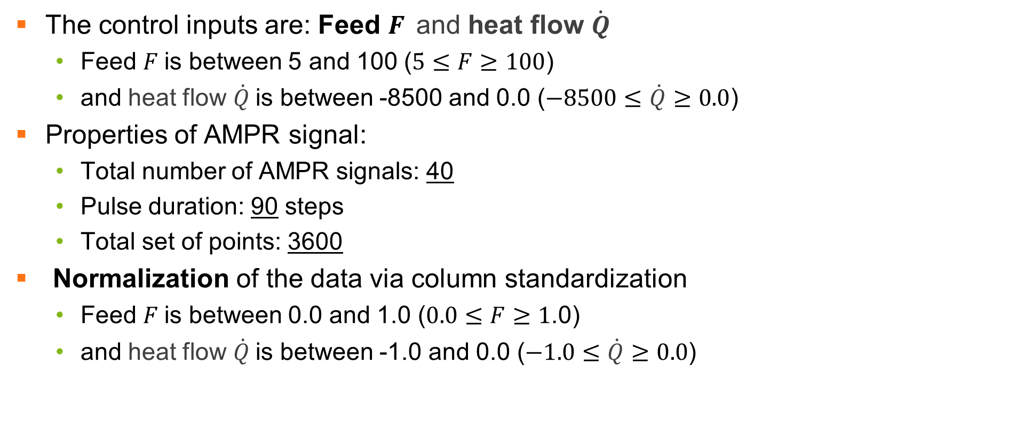
Amplitude Modulated Pseudo Random (AMPR) Signal
The control inputs are: Feed $F_{ }$and heat flow $\dot{Q}$
Feed $F$is between 5 and 100 ($5≤F≥100$)
and heat flow $\dot{Q}$is between -8500 and 0.0 ($−8500≤\dot{Q}≥0.0$)
Properties of AMPR signal:
Total number of AMPR signals: 40
Pulse duration: 90 steps
Total set of points: 3600
Normalization of the data via column standardization
Feed $F$is between 0.0 and 1.0 ($0.0≤F≥1$.0)
and heat flow $\dot{Q}$is between -1.0 and 0.0 ($−1.0≤\dot{Q}≥0.0$)

Slide 11
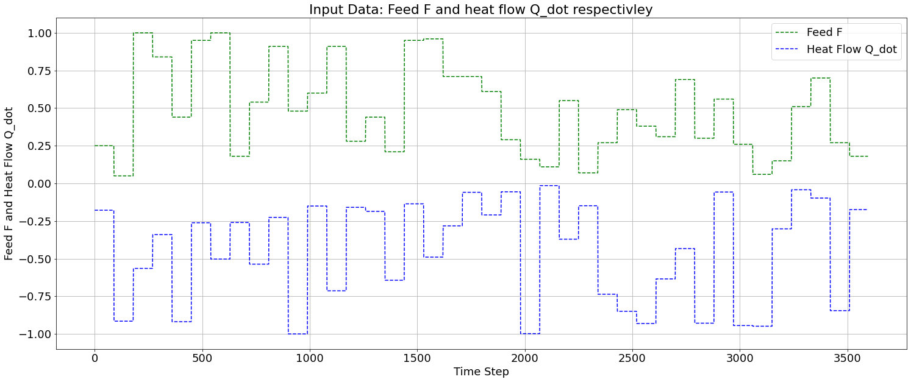

Slide 12
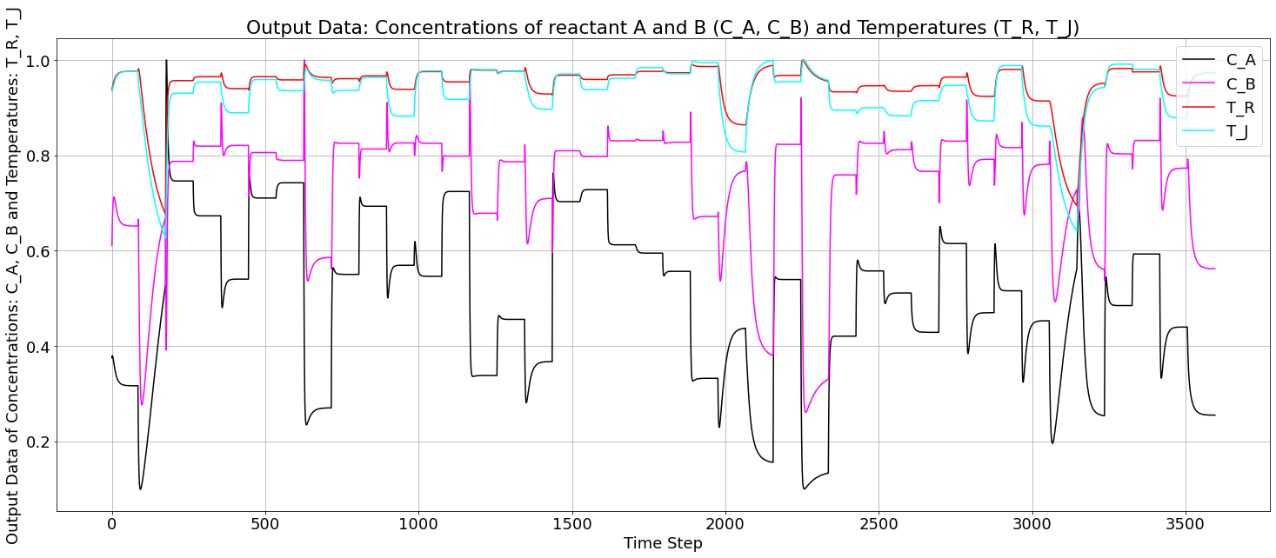
Simulated Normalized Output of the CSTR Model: ($C_{A}, C_{B}, T_{R}, T_{K}$)

Slide 13
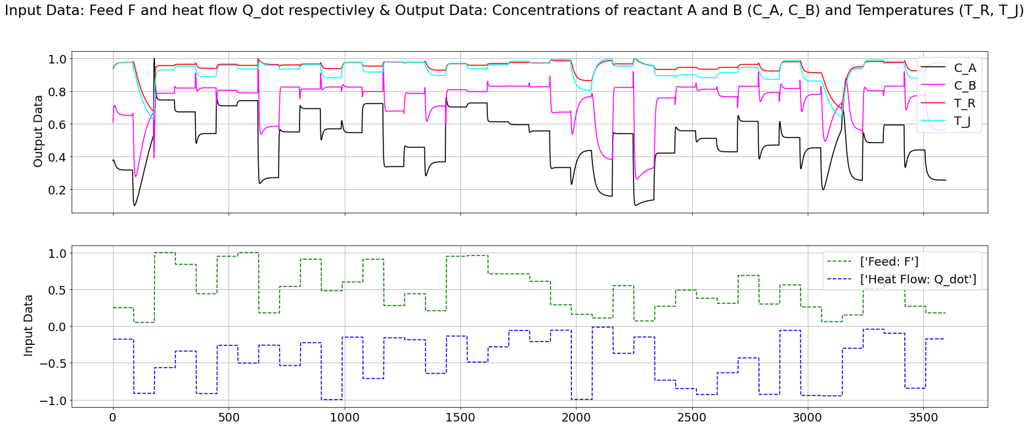
Combined Data: Inputs and Outputs

Slide 14
CSTR Implementation
Vanilla Neural Network
Hyperparameter Tuning with Keras Tuner
Physics Guided Neural Network

Slide 15
Vanilla Neural Network
Nonlinear Autoregressive Exogenous Model (NARX)

Slide 16
Nonlinear Autoregressive Exogenous Model (NARX)
“In time series modeling, a nonlinear autoregressive exogenous model (NARX) is a nonlinear autoregressive model which has exogenous inputs”.
Time Series: series of data points indexed in time order (discrete-time data),
Nonlinear: system in which the change of the output is not proportional to the input,
Autoregressive: the output variable depends linearly on its own previous values and on a stochastic term,
Exogenous: object originating externally.

Slide 17
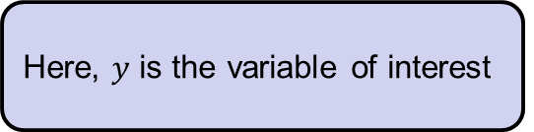

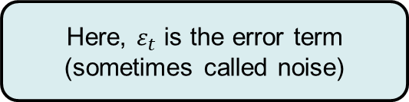
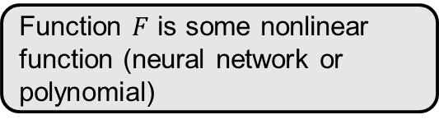
NARX Model
$$y_{t}=F \left( y_{t−1},y_{t−2},y_{t−3}, …,u_{t},u_{t−1},u_{t−2},u_{t−3}, … \right)+ ε_{t}$$
Here, $ε_{t}$ is the error term (sometimes called noise)
Here, $y$ is the variable of interest
The model depends on the past values of the same series
Function $F$ is some nonlinear function (neural network or polynomial)
The model also depends on the current and past values of the exogenous series

Slide 18
CSTR Implementation
Vanilla Neural Network
Hyperparameter Tuning with Keras Tuner
Physics Guided Neural Network

Slide 19
Hyperparameter Tuning
KerasTuner API for HyperParameters Tuning

Slide 20
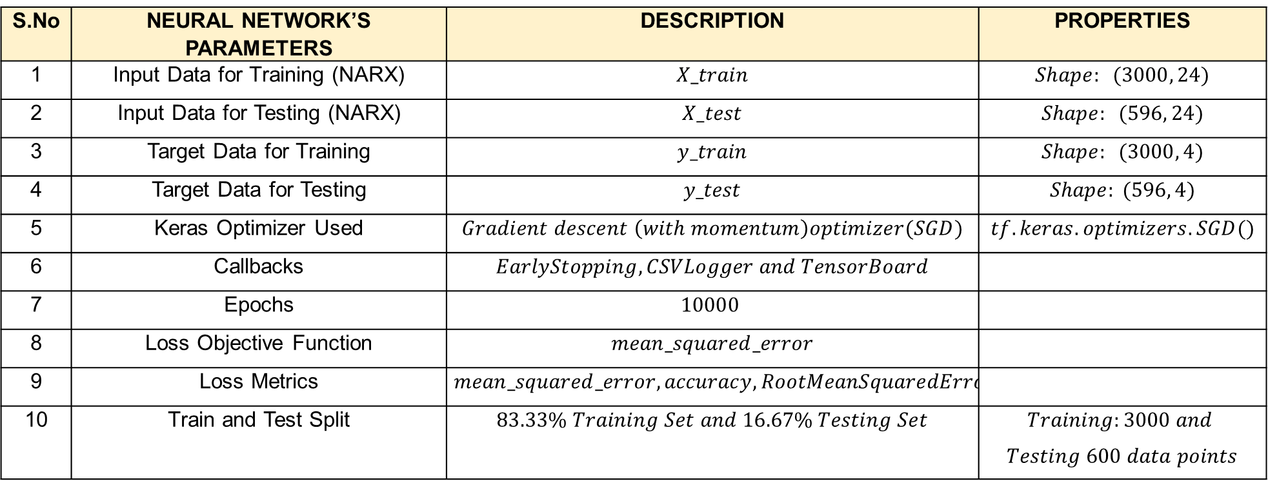
Parameters of the Neural Network
S.No | NEURAL NETWORK’S PARAMETERS | DESCRIPTION | PROPERTIES
1 | Input Data for Training (NARX) | $$X_train$$ | $$Shape: (3000, 24)$$
2 | Input Data for Testing (NARX) | $$X_test$$ | $$Shape: (596, 24)$$
3 | Target Data for Training | $$y_train$$ | $$Shape: (3000, 4)$$
4 | Target Data for Testing | $$y_test$$ | $$Shape: (596, 4)$$
5 | Keras Optimizer Used | $$Gradient descent \left(with momentum\right)optimizer(SGD)$$ | $$tf.keras.optimizers.SGD()$$
6 | Callbacks | $$EarlyStopping, CSVLogger and TensorBoard$$
7 | Epochs | $$10000$$
8 | Loss Objective Function | $$mean_squared_error$$
9 | Loss Metrics | $$mean_squared_error, accuracy, RootMeanSquaredError$$
10 | Train and Test Split | $$83.33\% Training Set and 16.67\% Testing Set$$ | $$Training:3000 and$$ $$Testing 600 data points$$

Slide 21
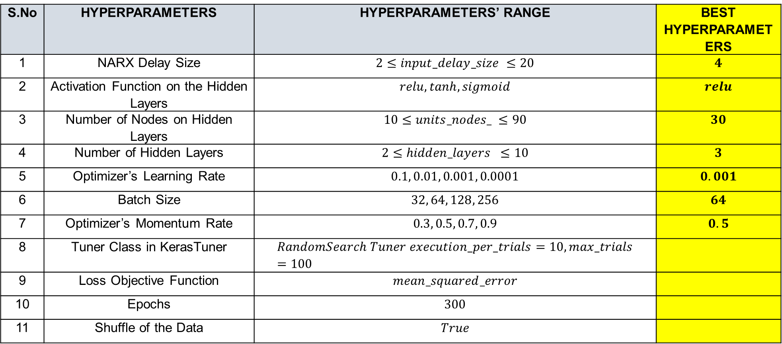
Hyperparameters Found with KerasTuner
S.No | HYPERPARAMETERS | HYPERPARAMETERS’ RANGE | BEST HYPERPARAMETERS
1 | NARX Delay Size | $$2≤input_delay_size ≤20$$ | $$4$$
2 | Activation Function on the Hidden Layers | $$relu, tanh, sigmoid$$ | $$relu$$
3 | Number of Nodes on Hidden Layers | $$10≤units_nodes_ ≤90$$ | $$30$$
4 | Number of Hidden Layers | $$2≤hidden_layers ≤10$$ | $$3$$
5 | Optimizer’s Learning Rate | $$0.1, 0.01, 0.001, 0.0001$$ | $$0.001$$
6 | Batch Size | $$32, 64, 128, 256$$ | $$64$$
7 | Optimizer’s Momentum Rate | $$0.3, 0.5, 0.7, 0.9$$ | $$0.5$$
8 | Tuner Class in KerasTuner | $$RandomSearch Tuner execution_per_trials=10,max_trials=100$$
9 | Loss Objective Function | $$mean_squared_error$$
10 | Epochs | $$300$$
11 | Shuffle of the Data | $$True$$

Slide 22
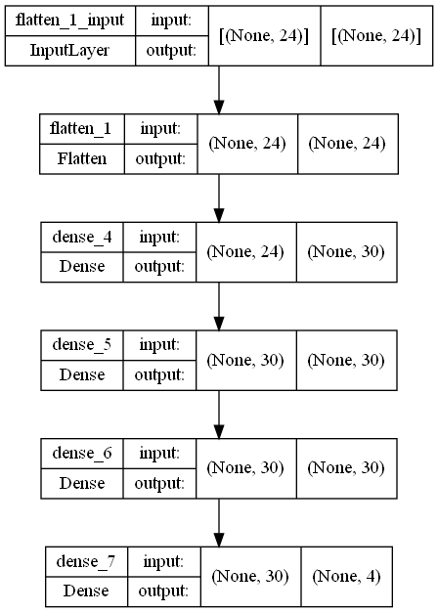
Neural Network Based on the Best Hyperparameters
Model: "sequential_1"
_________________________________________________________________
Layer (type) Output Shape Param #
=================================================================
flatten_1 (Flatten) (None, 24) 0
dense_4 (Dense) (None, 30) 750
dense_5 (Dense) (None, 30) 930
dense_6 (Dense) (None, 30) 930
dense_7 (Dense) (None, 4) 124
=================================================================
Total params: 2,734
Trainable params: 2,734
Non-trainable params: 0
_________________________________________________________________

Slide 23
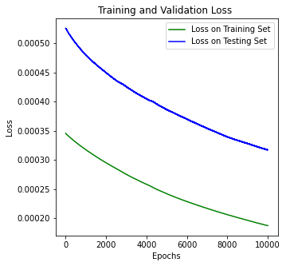
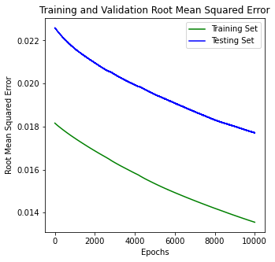
Neural Network’s Metrices
Loss on Training Set: 1.8705e-04
Loss on Testing Set: 3.1722e-04
Root Mean Square on Training Set: 0.0136
Root Mean Square on Testing Set: 0.0177

Slide 24
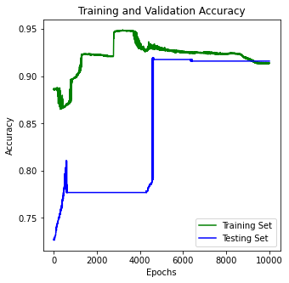
Neural Network’s Metrices
Accuracy on Training Set: 0.9137
Accuracy on Testing Set: 0.9161

Slide 25
Hyperparameter Tuning
Open Loop Neural Network’s Behavior

Slide 26
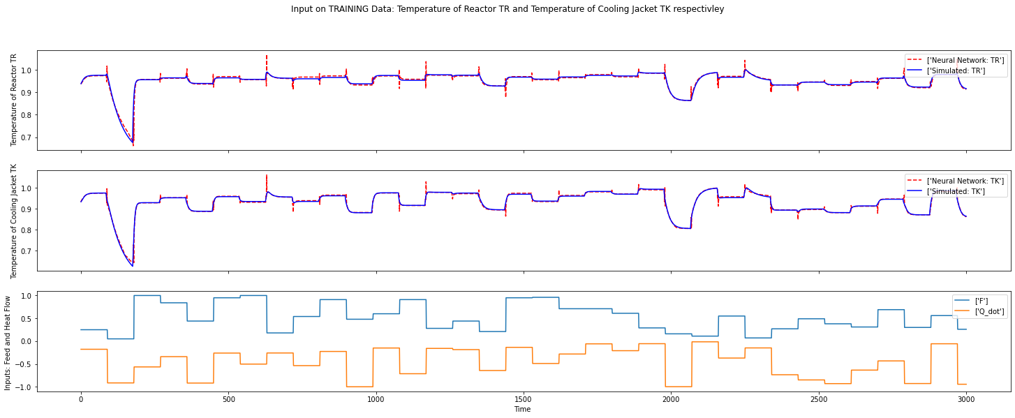
On Training Data: The Temperature Inside The Reactor (Tr) And The Temperature Of The Cooling Jacket (Tk)

Slide 27
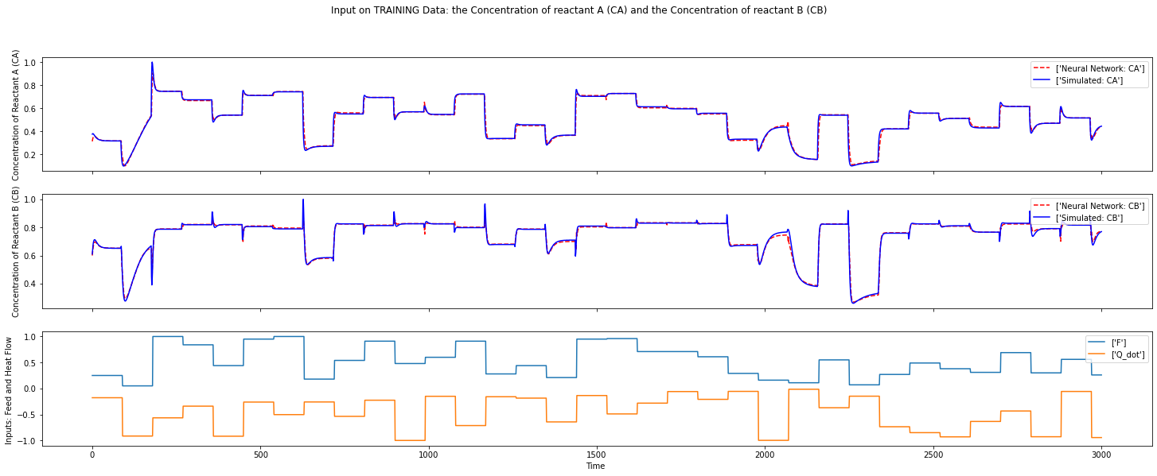
On Training Data: The Concentration Of Reactant A (Ca) And The Concentration Of Reactant B (Cb)

Slide 28
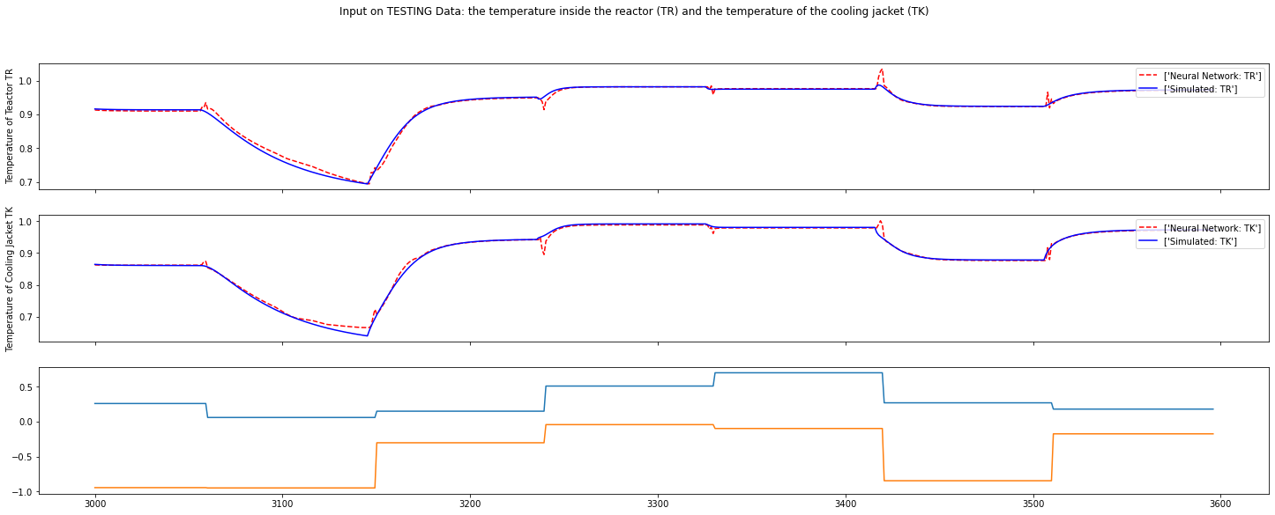
On Testing Data: The Temperature Inside The Reactor (Tr) And The Temperature Of The Cooling Jacket (Tk)

Slide 29
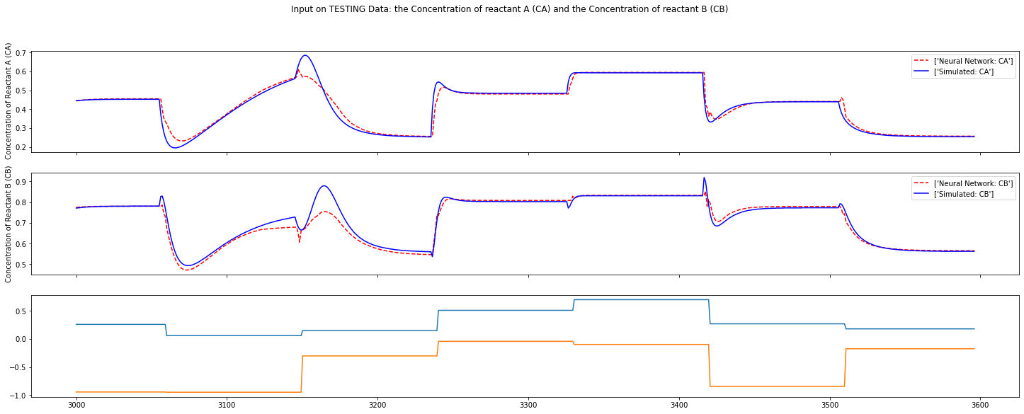
On Testing Data: The Concentration Of Reactant A (Ca) And The Concentration Of Reactant B (Cb)

Slide 30
Hyperparameter Tuning
Closed Loop Neural Network’s Behavior

Slide 31
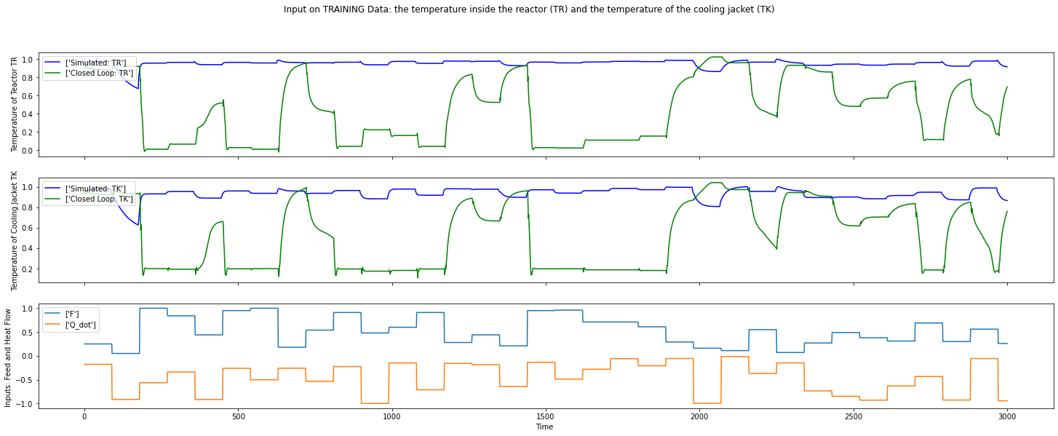
On Training Data: The Temperature Inside The Reactor (Tr) And The Temperature Of The Cooling Jacket (Tk)

Slide 32
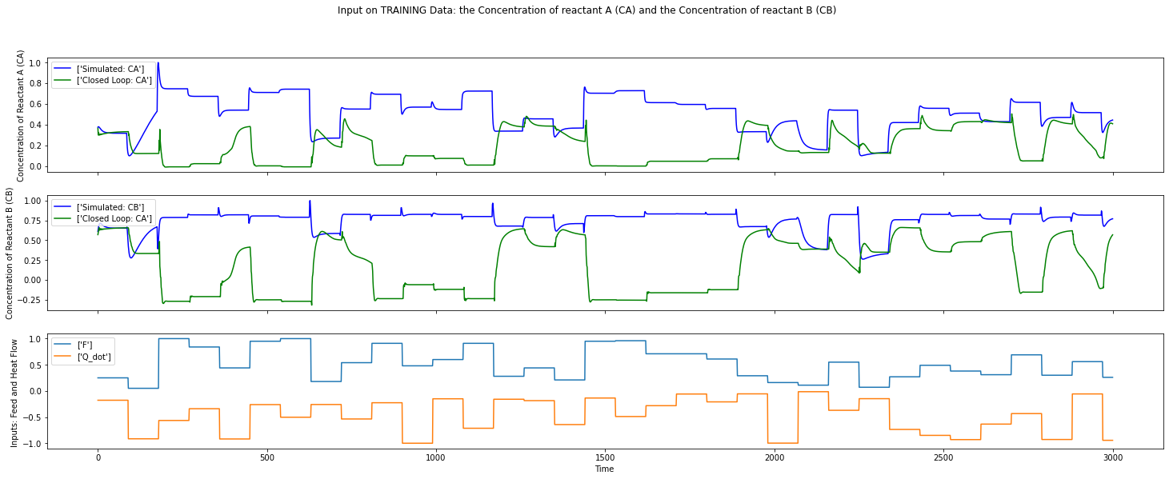
On Training Data: The Concentration Of Reactant A (Ca) And The Concentration Of Reactant B (Cb)

Slide 33
Hyperparameter Tuning
Combining Open and Closed Loops Neural Network’s Behavior

Slide 34
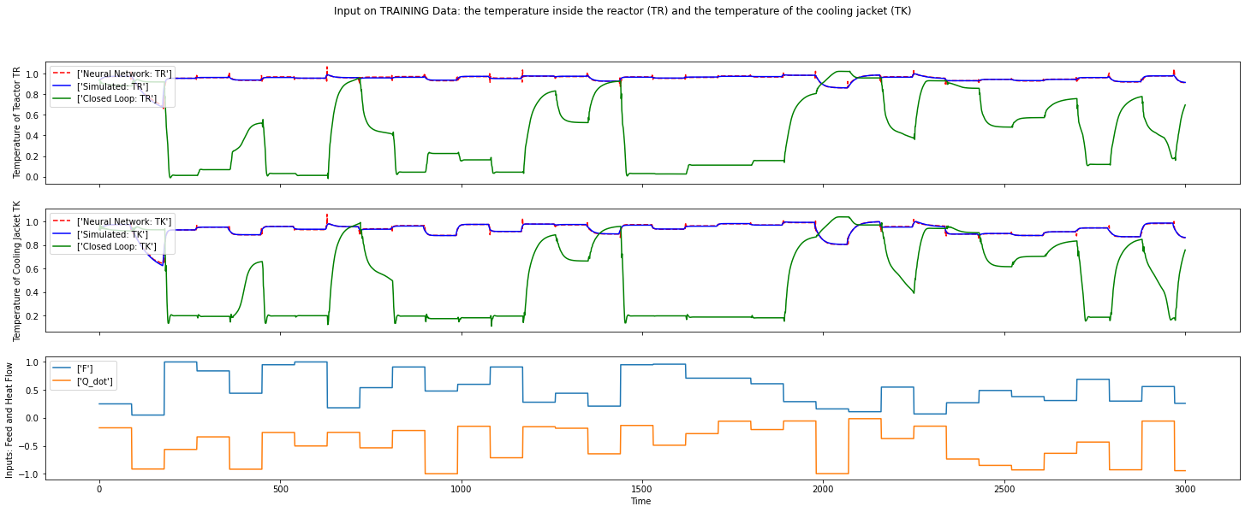
On Training Data: The Temperature Inside The Reactor (Tr) And The Temperature Of The Cooling Jacket (Tk)

Slide 35
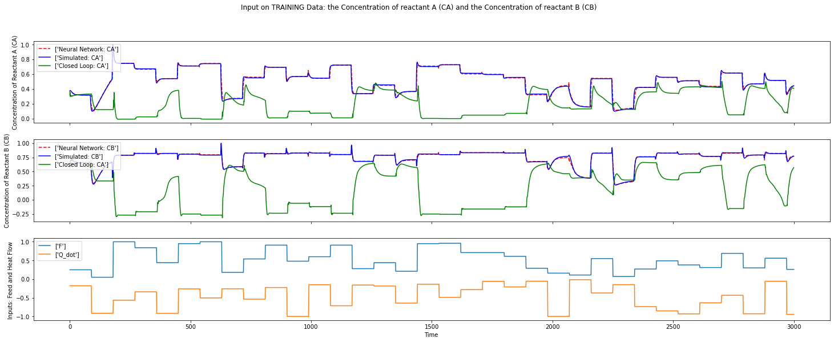
On Training Data: The Concentration Of Reactant A (Ca) And The Concentration Of Reactant B (Cb)

Slide 36
CSTR Implementation
Vanilla Neural Network
Hyperparameter Tuning with Keras Tuner
Physics Guided Neural Network

Slide 37
Physics Guided Neural Network (PGNN)
Closed Loop Neural Network’s Behavior

Slide 38
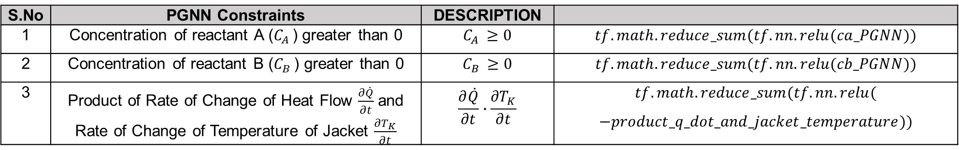
Constraints Implemented on Physics Guided Neural Network (PGNN)
S.No | PGNN Constraints | DESCRIPTION
1 | Concentration of reactant A ($C_{A }$) greater than 0 | $$C_{A }≥0$$ | $$tf.math.reduce_sum(tf.nn.relu(ca_PGNN))$$
2 | Concentration of reactant B ($C_{B }$) greater than 0 | $$C_{B }≥0$$ | $$tf.math.reduce_sum(tf.nn.relu(cb_PGNN))$$
3 | Product of Rate of Change of Heat Flow $\frac{∂\dot{Q}}{∂t}$and Rate of Change of Temperature of Jacket $\frac{{∂T}_{K}}{∂t}$ | $$\frac{∂\dot{Q}}{∂t}∙\frac{{∂T}_{K}}{∂t}$$ | $$tf.math.reduce_sum(tf.nn.relu($$ $$−product_q_dot_and_jacket_temperature))$$

Slide 39
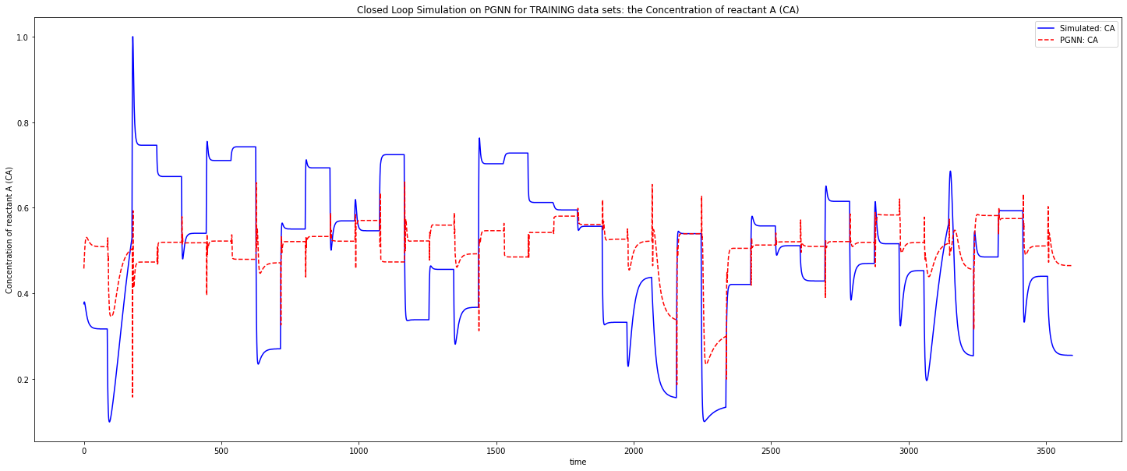
On Training and Testing Data Combined : the Concentration of reactant A (CA):

Slide 40
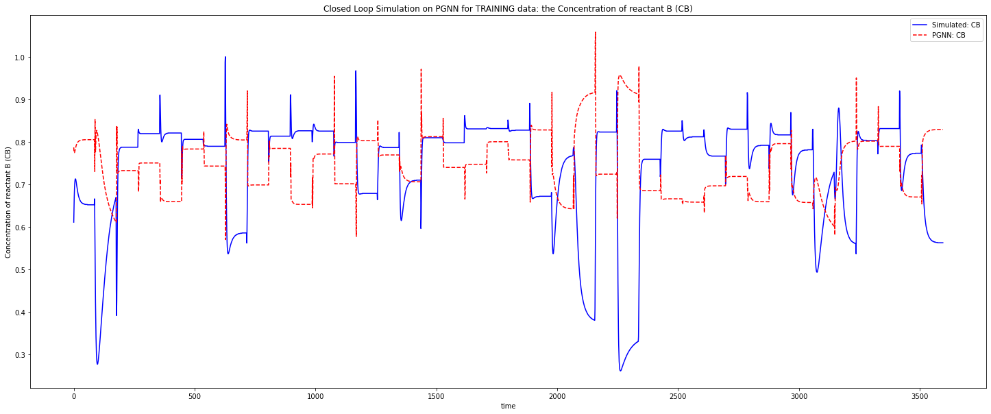
On Training and Testing Data Combined : the Concentration of reactant B (CB):

Slide 41


THANK YOU
We will now proceed to Questions and Answers’ (Q&A) session

